Slide 1

A data-driven framework for analysis and prediction of instabilities in a smart power grid
A four house network example

Slide 2
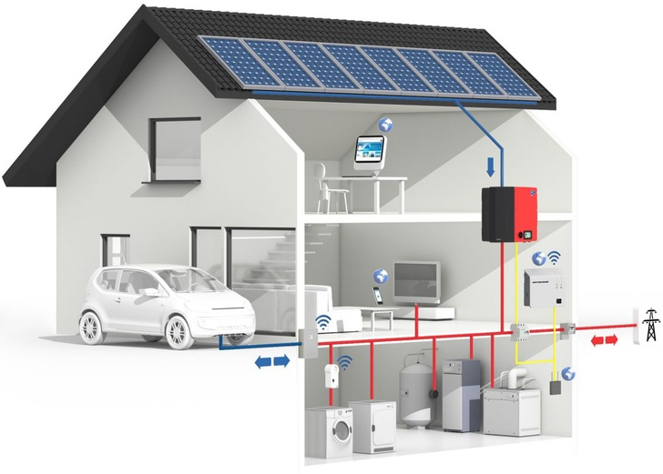
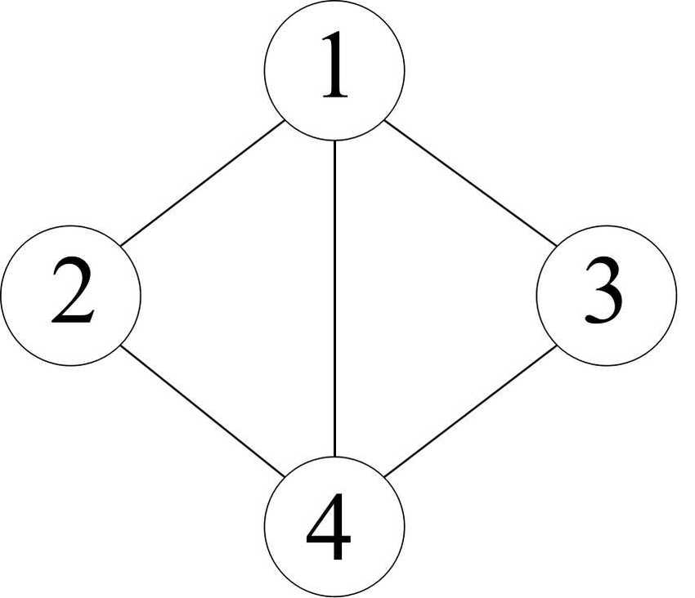
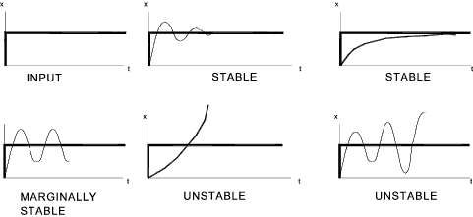
Smart grid stability
A solar home
A grid with four solar homes
Stability: A system is said to be stable, if its output is under control.

Slide 3




What makes a grid “stable”
Stability: A system is said to be stable, if its output is under control.
A grid with four solar homes

Slide 4
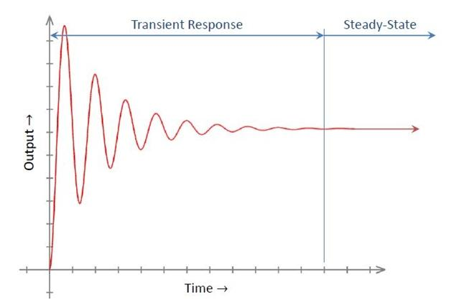
Variables at each house
Power consumed/generated (in kilo watts): p
Time constant/delay (in secs): tau
Price elasticity (in kilo watts per Hertz): g
Price elasticity: how much each house is willing to adapt their consumption/production
Time constant: a delay between transient and steady-state

Slide 5
Variables at each house
Power consumed/generated (in kilo watts): p
Time constant/delay (in secs): tau
Price elasticity (in kilo watts per Hertz): g
Price elasticity: how much each house is willing to adapt their consumption/production
Time constant: a delay between transient and steady-state

Slide 6
Data
Problem statement
How is the stability (output variable “stab”) of the network affected?
Model the relationship between the input variables (“tau”, “p”, “g”) and “stab”.
Predict the stability estimate and compare it with the actual test data.
Predict how the stability is affected by

Slide 7
Data
Problem statement
Predict how the stability is affected by

Slide 8
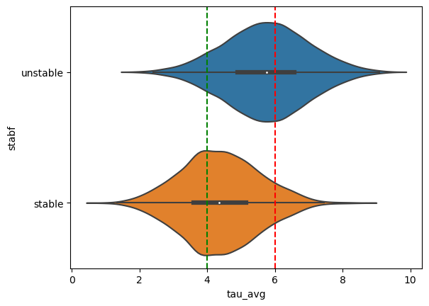
Time affects the stability

Slide 9
Time affects the stability

Slide 10
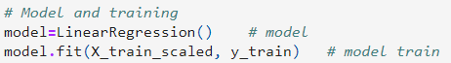
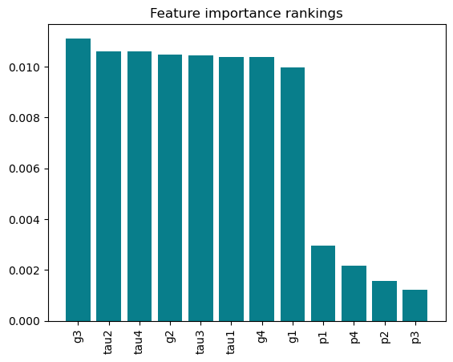
Linear regression-based modeling
X_train_scaled: scaled input variables for training the model
y_train: output variable used for training the model
model: the statistical model obtained
LinearRegression(): modeling methodology used

Slide 11
Modelling the importance of features against stability

Slide 12
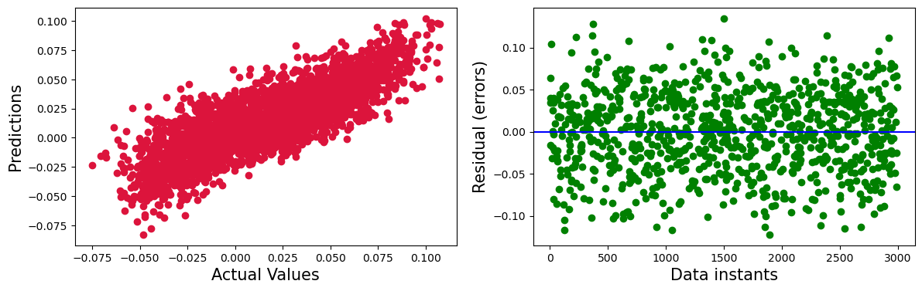
Linear regression-based output prediction
X_train_scaled: scaled input variables for testing the model
y_test_pred: predicted output variable used for

Slide 13
Linear regression-based output prediction

Slide 14
Summary
Presented insights into the relationship between input variables and stability
Designed a statistical regression-based model that maps the input variables to the stability estimate (output variable)
For a given test data, the output variable (stability estimate) is predicted by using the extracted model
The predicted output is cross validated with the actual output

Slide 15
Outcomes
Insights into network stability
A statistical regression-based model that for stability estimate
For a given tau, p and g, we can predict the stability of the network
The predicted output is cross validated with the actual output

Slide 16
So what?
Suppose that you want to energize a smart grid and you have no idea where to choose your parameters from.
Let us say you select a particular set of parameters
The presented model checks if the parameters selected would yield you stability

Slide 17
Useablity and extensions
As a general stability indicator tool in the design process
Can be extended for a larger network
For a new user/house to be connected to an existing network: the tool predicts whether the chosen parameters yield stability

Slide 18
Data source: https://archive.ics.uci.edu/ml/datasets/Electrical+Grid+Stability+Simulated+Data+

